Slide 1
Section1: GPIO - PWM - ADC

Slide 2
GPIO OUTPUT

Slide 3
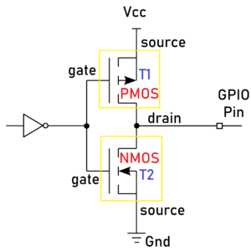
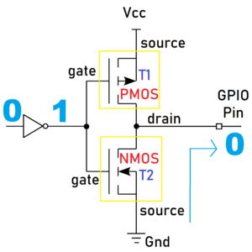
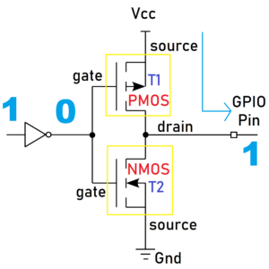
GPIO Output
T1 is the PMOS
and T2 is the NMOS.
When we write 1 from our code, the first inverter will make it as 0
T1 will be activated and T2 will be deactivated
T1 will take the Vcc and give it to the GPIO pin
Ouput HIGH
Output Low

Slide 4
Push-pull
This state is the default state of the GPIO output mode. The pin can “push” the signal high or “pull” it low using the PMOS transistor or NMOS transistor.
There is no need for pull-up or pull-down resistors as the PMOS and NMOS transistors do that job.

Slide 5
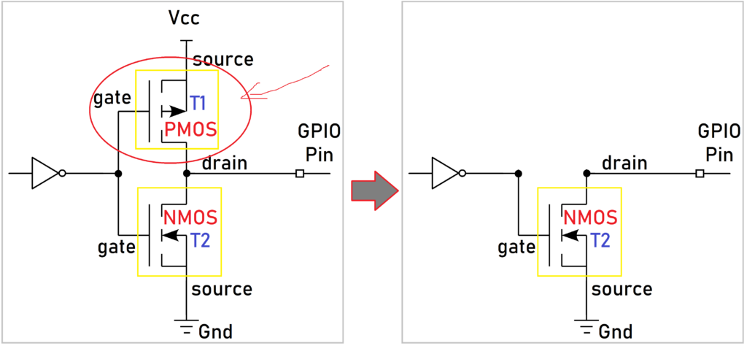
Open-Drain
In GPIO output mode, the output buffer is formed using the PMOS and NMOS transistors. If you remove the PMOS transistor, then it will be an open drain output mode.
The name comes from the fact that the MOSFET’s drain isn’t internally connected to anything. If you use BJT instead of MOSFET, then this is called an Open collector
When you make the NMOS to high, then it will supply a GND. The GPIO pin will be Low.
When you turn off the NMOS, the GPIO will not be connected to either Vcc or GND. It will be in a floating state. So, the output will be either Low or high impedance (floating). It can pull the pin towards the ground, but it cannot drive it high.
Open drain outputs are most commonly used in communication interfaces where multiple devices are connected on the same line (e.g. I2C, One-Wire, etc.). When all of the outputs of the devices connected to the line are in the Hi-Z state, the line is driven to a default logic 1 level by a pull-up. Any device can pull the line to logic 0 using its open drain ouput and all devices can see this level.

Slide 6
GPIO INPUT

Slide 7
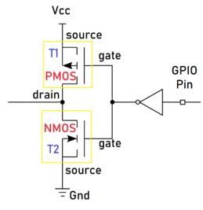
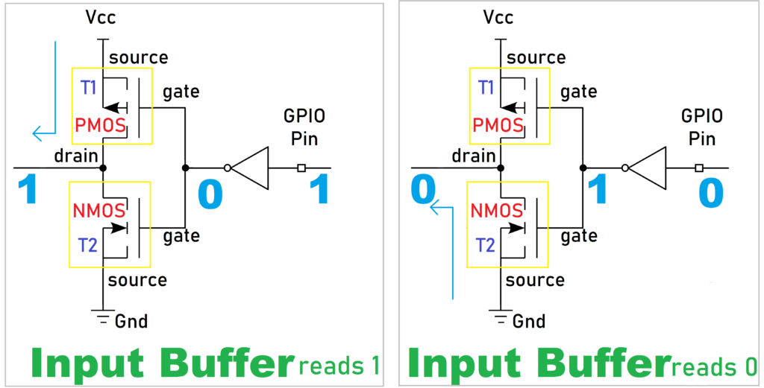
GPIO Input
When input GPIO = 1, the inverter makes it as 0
PMOS T1 is activated and the NMOS T2 is deactivated
T1 will take the Vcc and give it to the processor 🡪 get 1 in the software program
Opposite behaviors occur when GPIO pin = 0

Slide 8
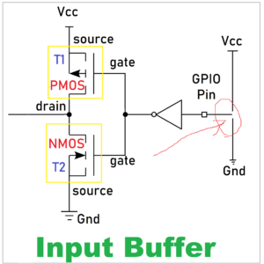
High-impedance
Whenever the microcontroller is powered ON, the GPIO pins are by default in this HIGH impedance state input mode.
High-impedance or HI-Z State of a GPIO is the state when a pin is floating by not connecting to either HIGH (VCC) or LOW (GND) Voltage levels.
Its state is indeterminate (cannot determine the logic level, which is 0 or 1) unless it is driven high or low externally.
Floating state can lead to leakage current, which may result in high power consumption because a floating pin is highly susceptible to picking up the noise and may result in leakage current.
🡪 It is recommended to keep the unused pins in either a pull-up or pull-down state to avoid leakage of current.

Slide 9
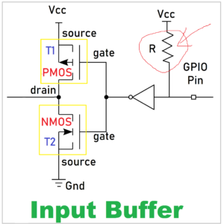
Pull Up
The internal pull-up resistor is connected to the pin. So, the state will be HIGH unless an external pull-down resistor is used.
There will be a particular register to enable this pull-up resistor in the microcontroller (check on the datasheet)

Slide 10
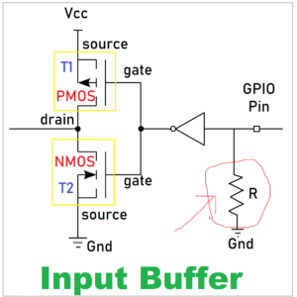
Pull Down
In this type, the internal pull-down resistor is connected to the pin. So, the state will be Low unless an external pull-up resistor is used.
There will be a particular register to enable this pull-down resistor in the microcontroller.

Slide 11
Pulse Width Modulation (PWM)

Slide 12
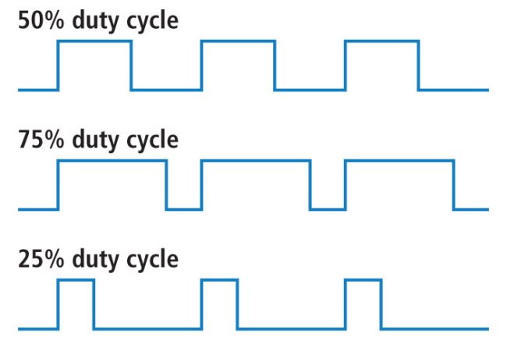
Frequency and Duty Cycle
All waves have the same frequency but different duty-cycle

Slide 13
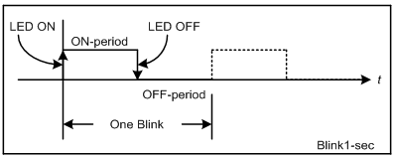
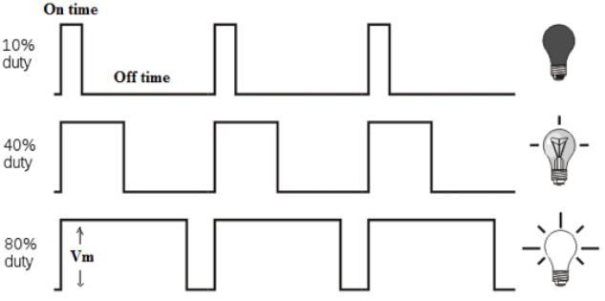
LED Blinky with PWM
Cycle (T) = On-period + OFF-period (s)
Frequency (F) = 1 /T (Hz)
Duty Cycle = ON-period/T (%)

Slide 14
Analog To Digital Converter (ADC)

Slide 15
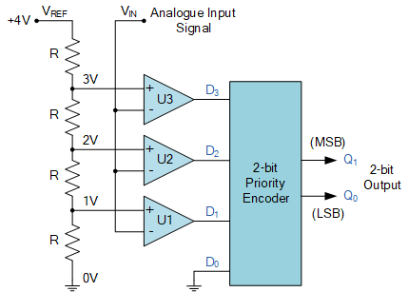
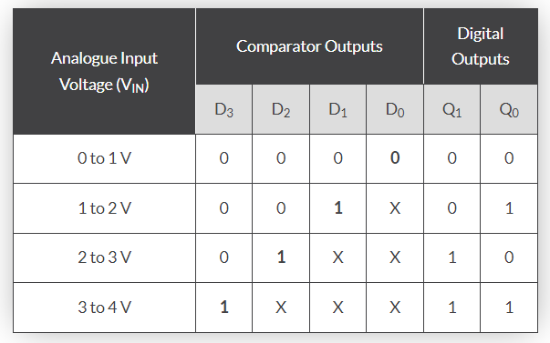
ADC Circuit
X means don’t care (X = 0 or 1)
ADC 2 bits
Voltage resolution = 1V

